Slide 1


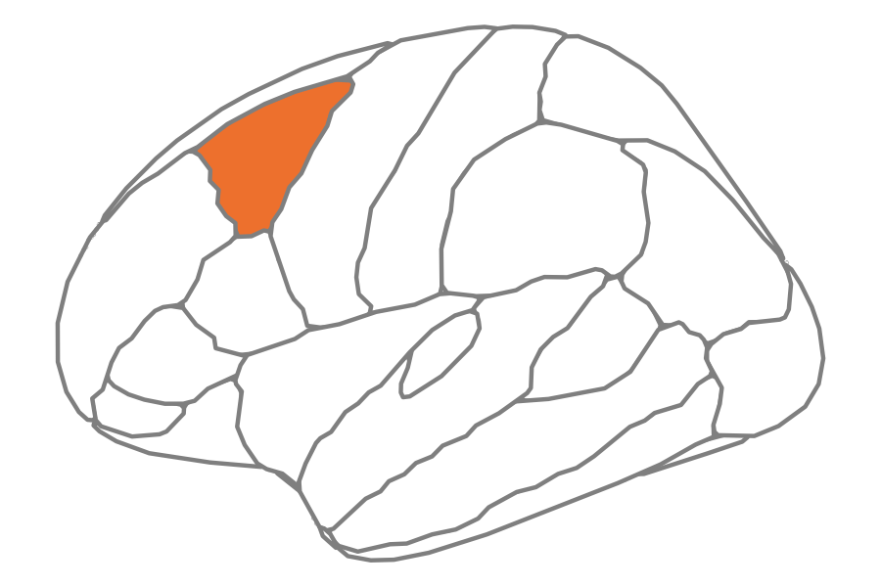
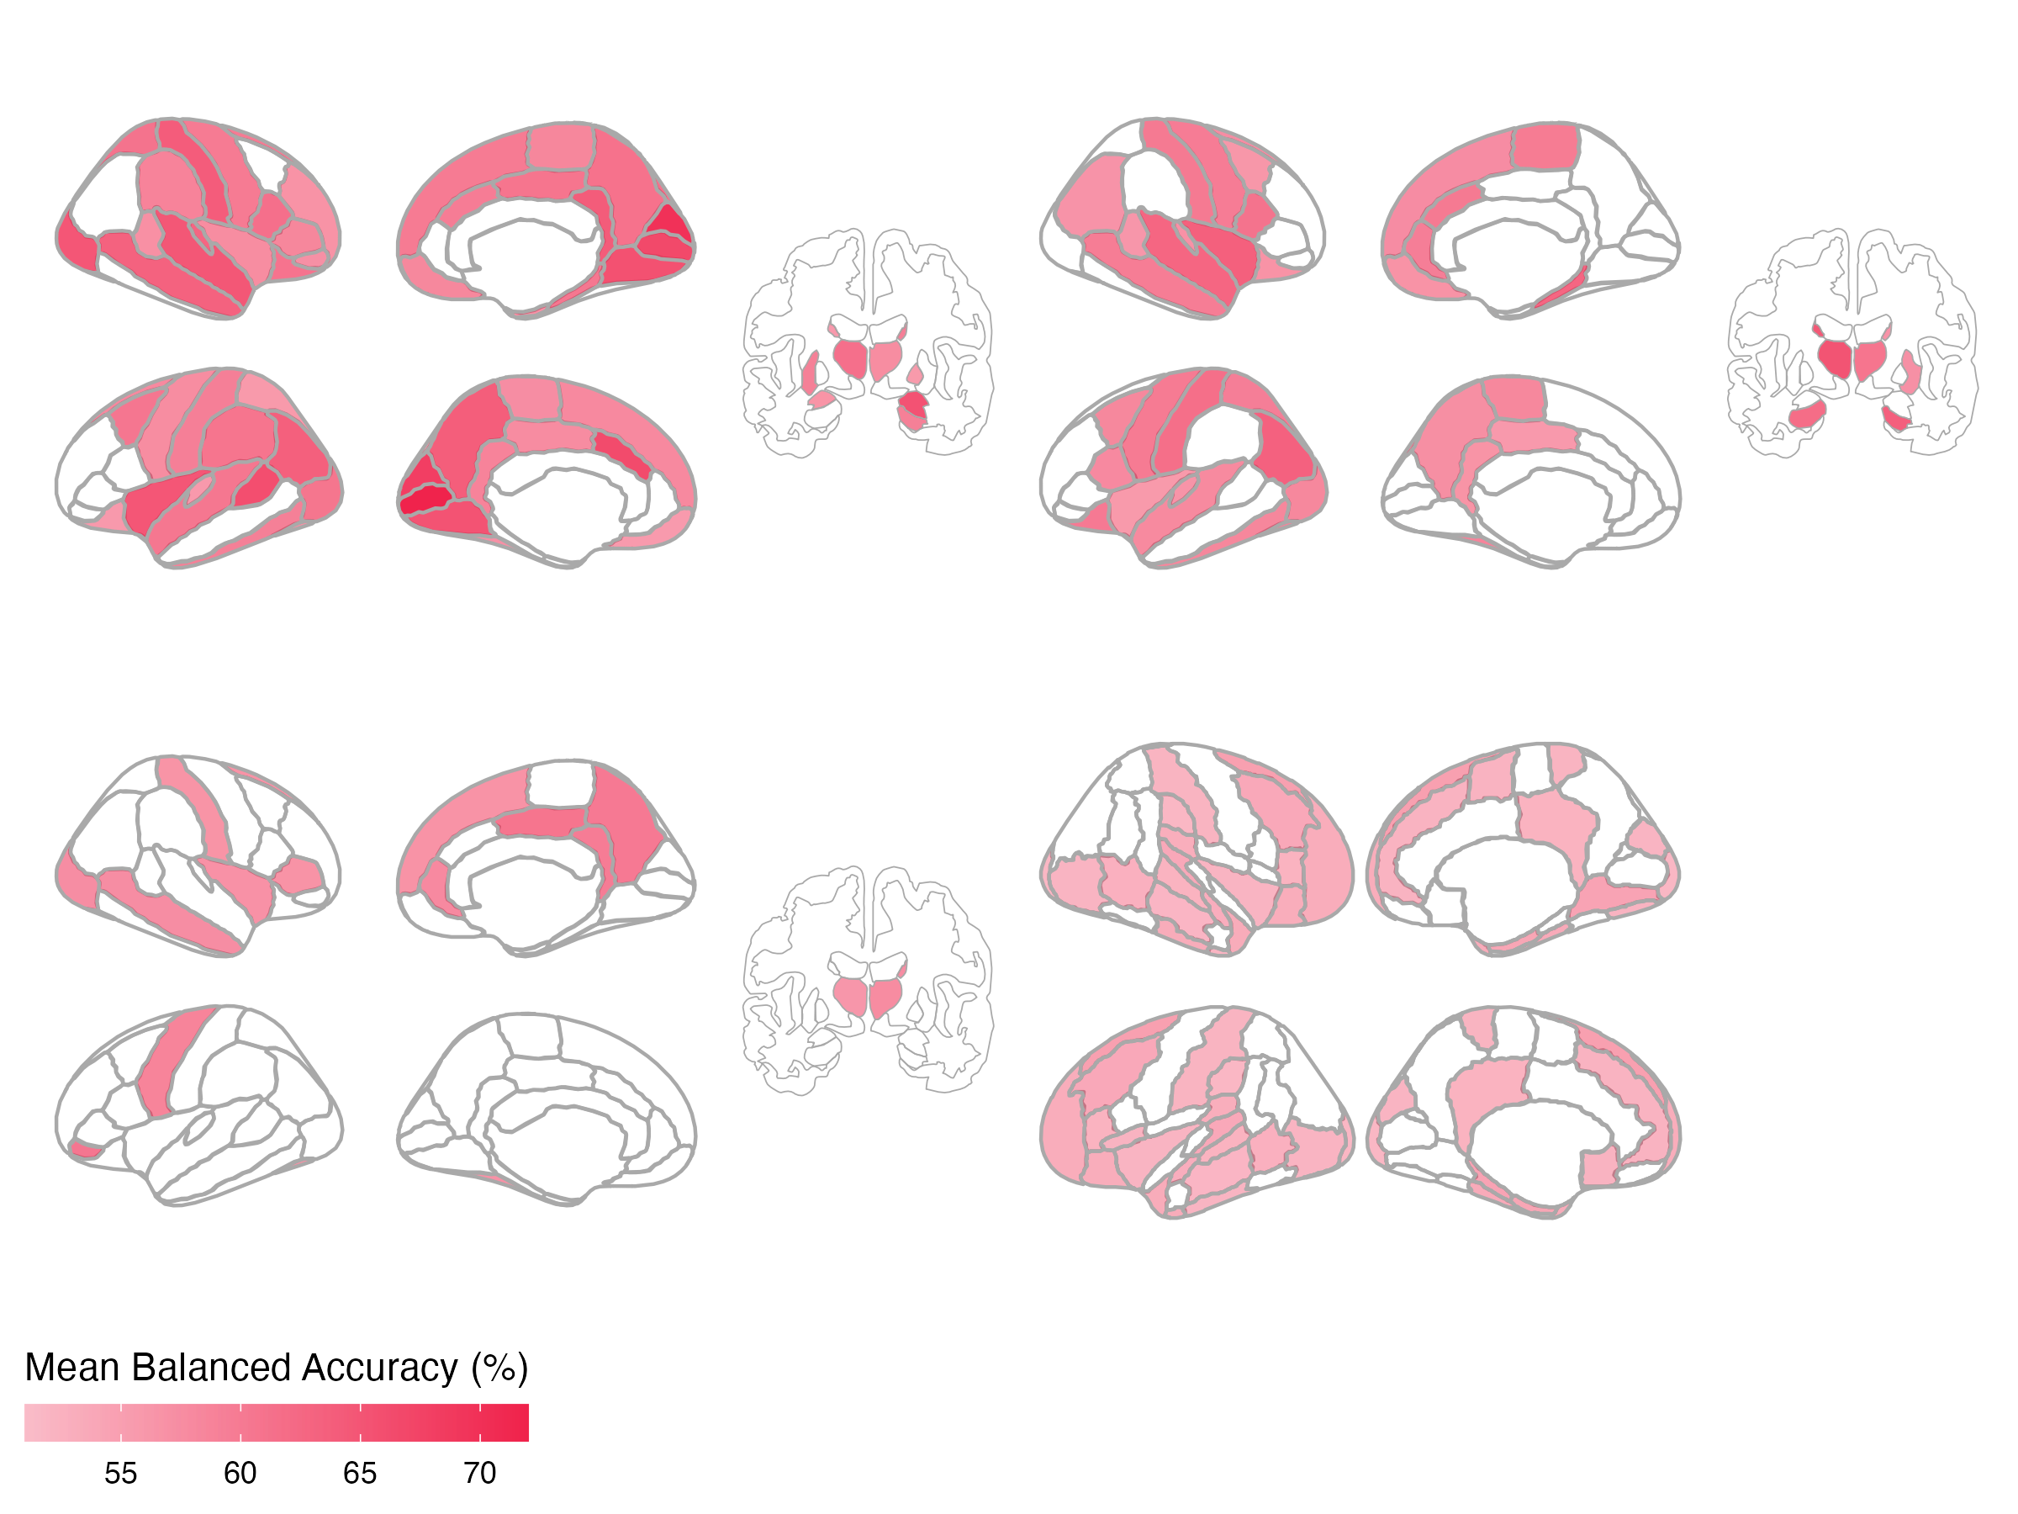
A
Features
Region 1
Region 1
Repeat for all N brain regions
Linear SVM
B
SCZ
BPD
R
63 regions
44 regions
L
ADHD
ASD
17 regions
27 regions
Notes:
Figure 2. Univariate time-series feature classification results.

Slide 2
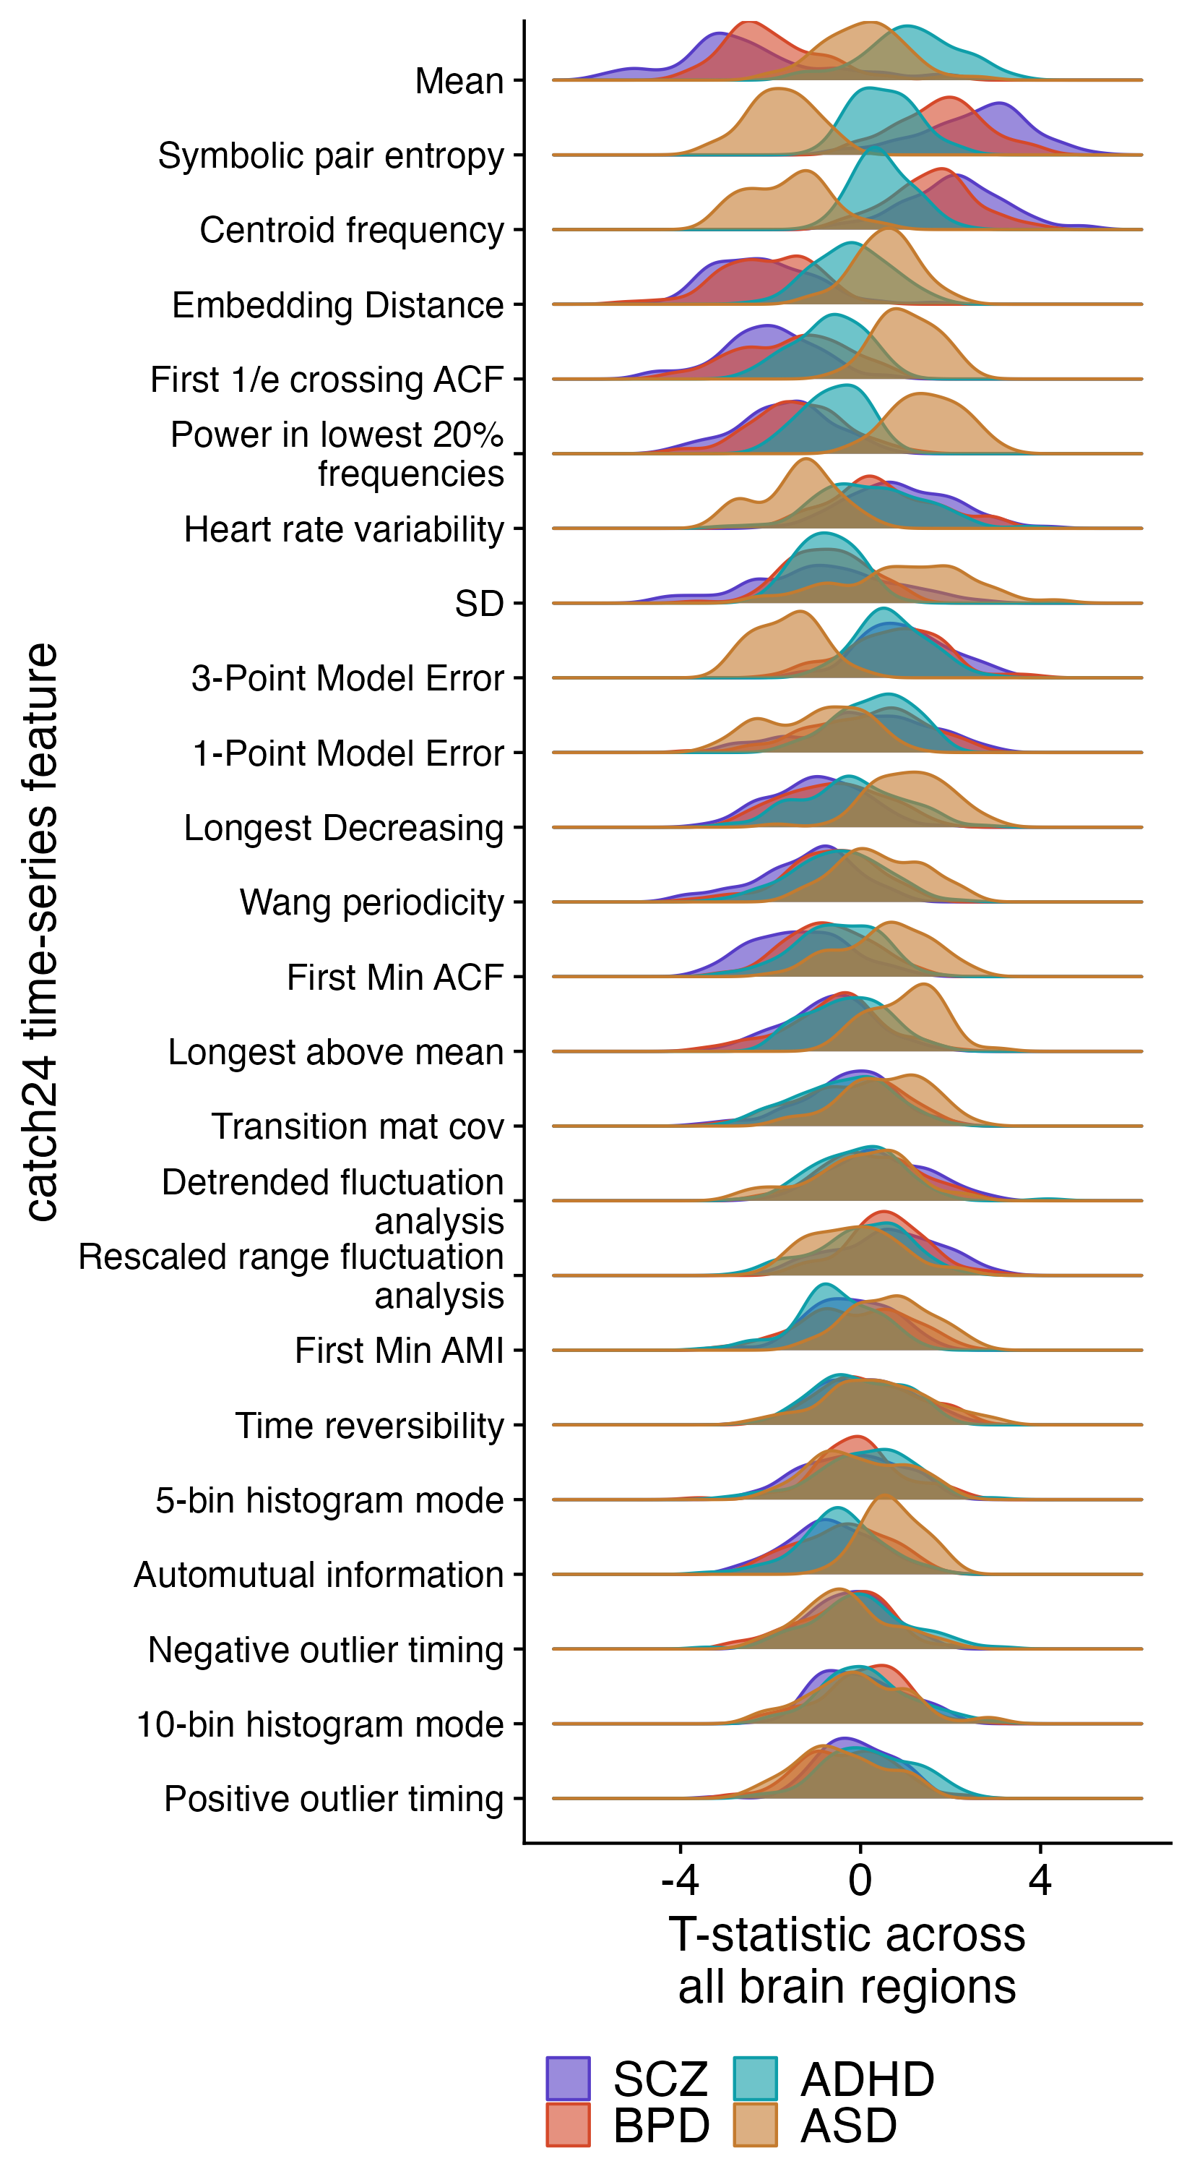
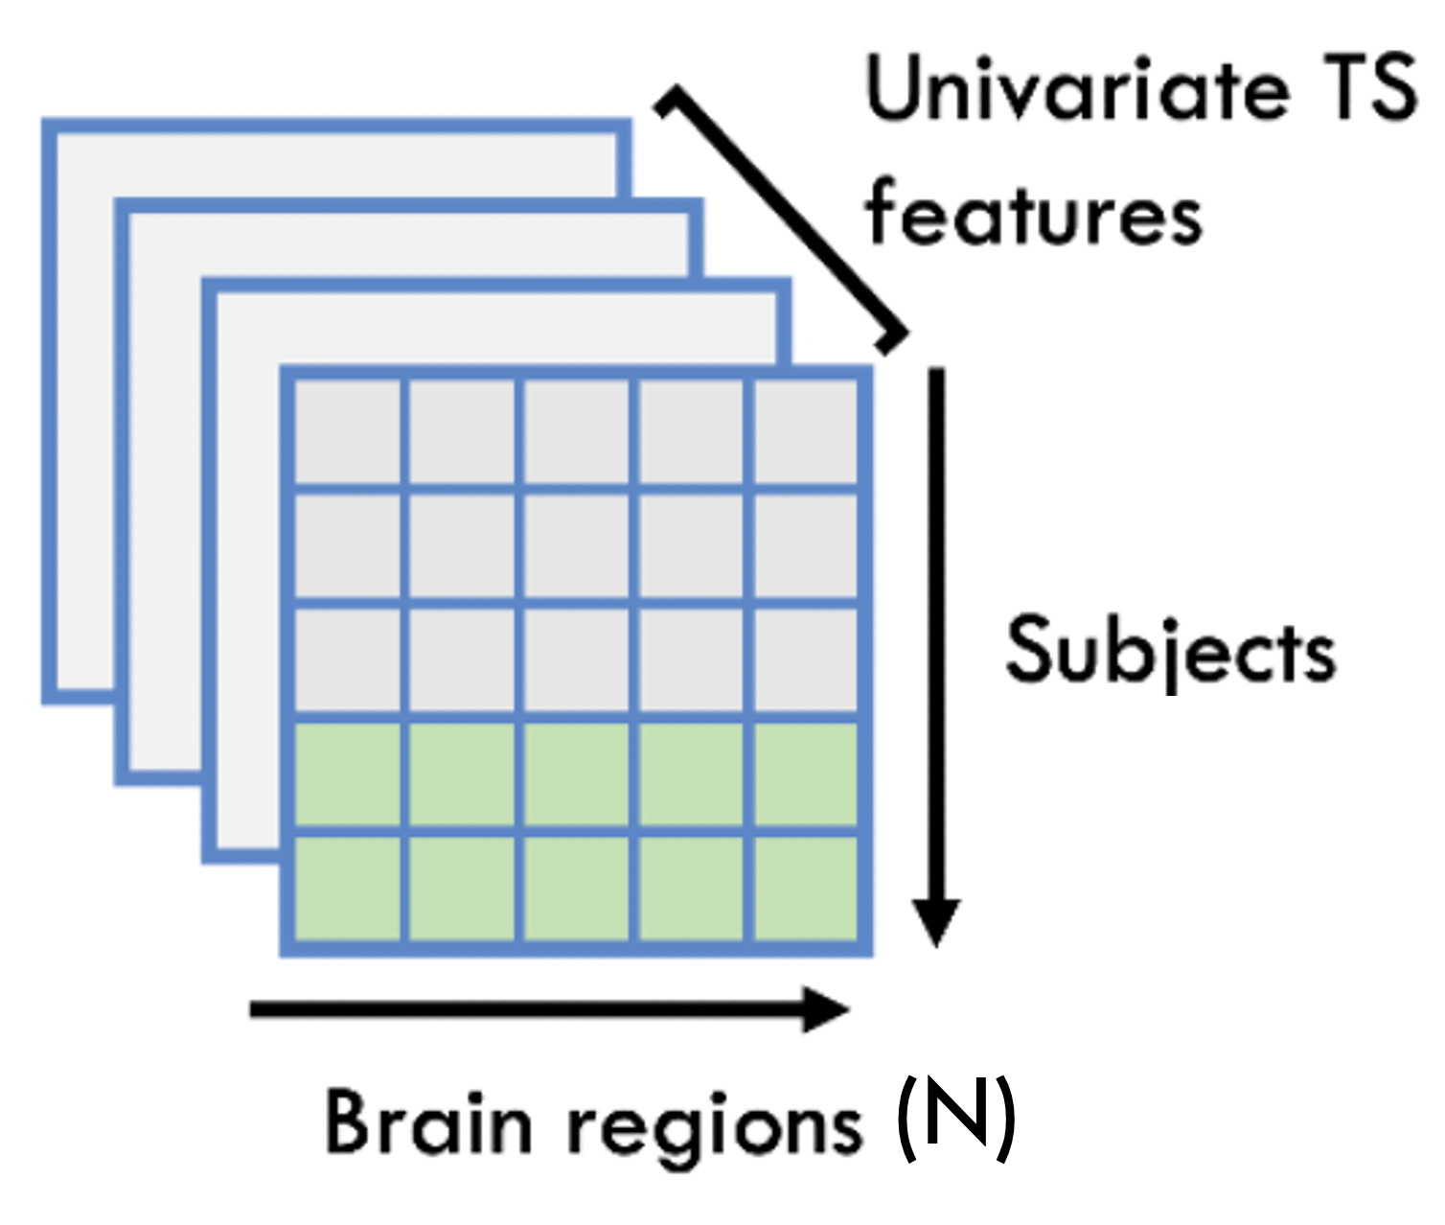
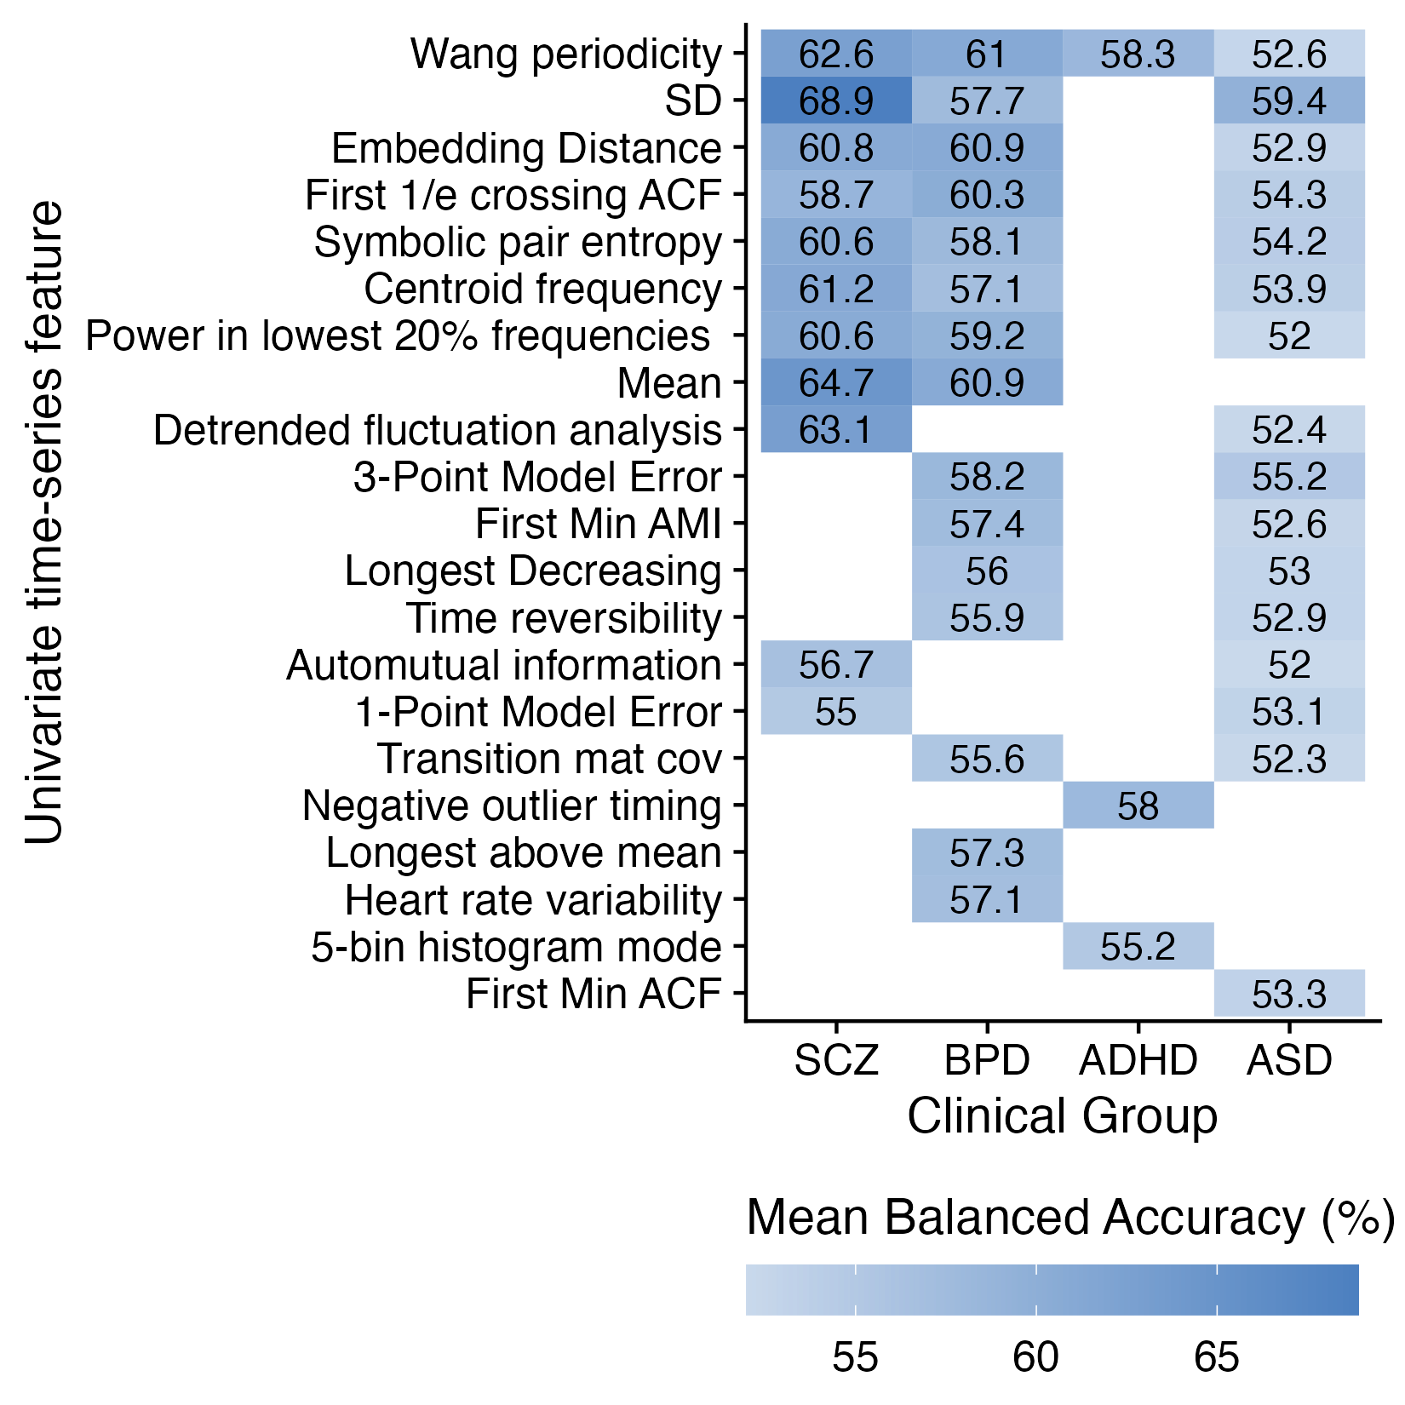
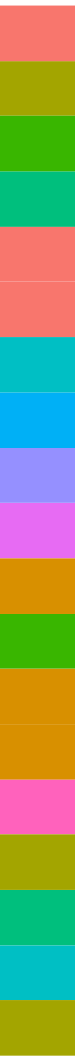
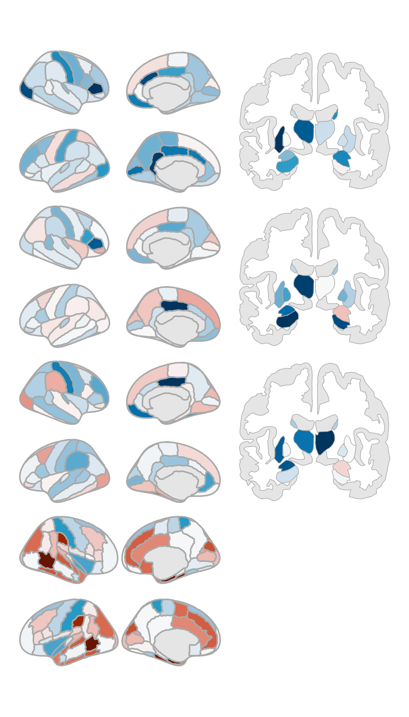
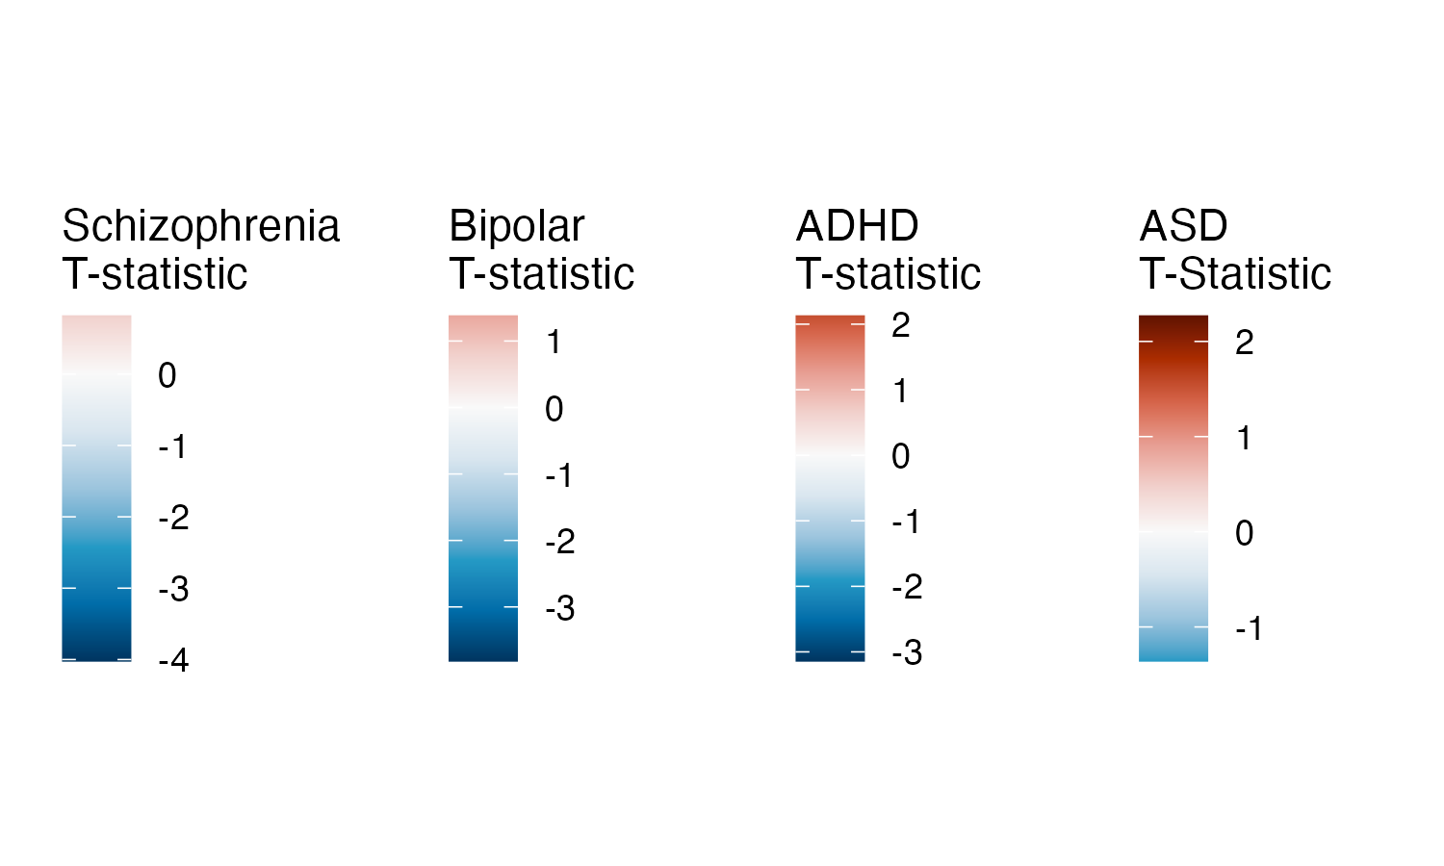
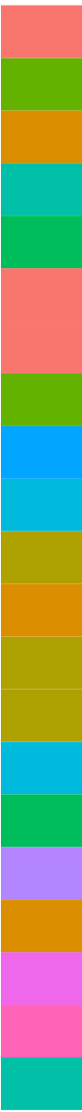
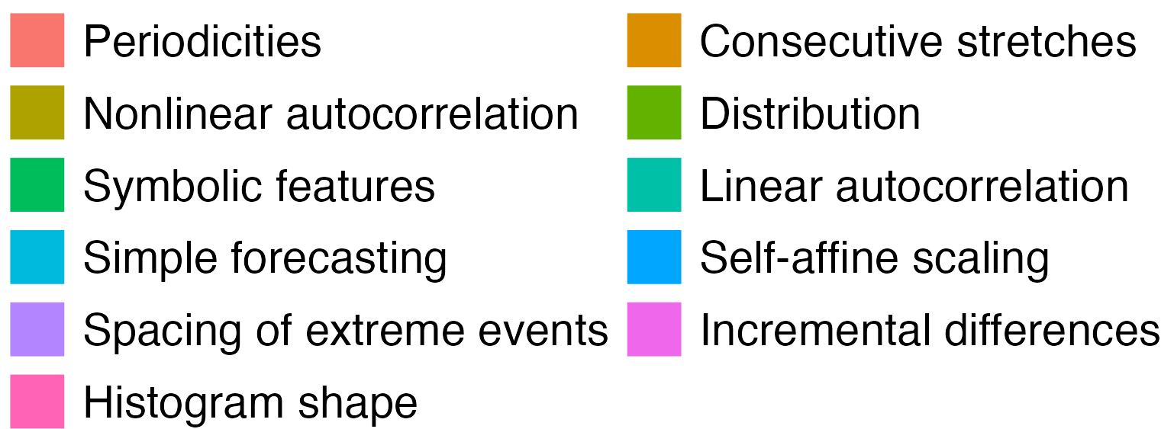
A
D
Features
Feature 1
Feature 1
Repeat for all 24 TS features
Linear SVM
B
C
Notes:
Figure 2. Univariate time-series feature classification results.

Slide 3
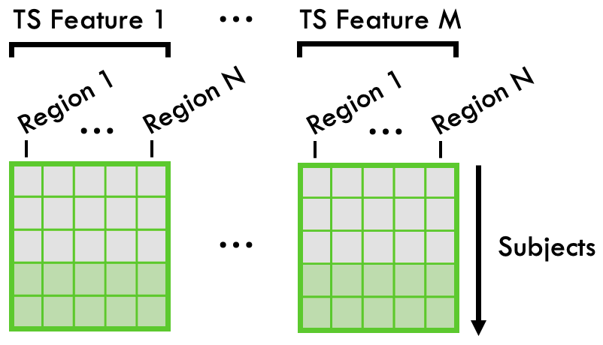
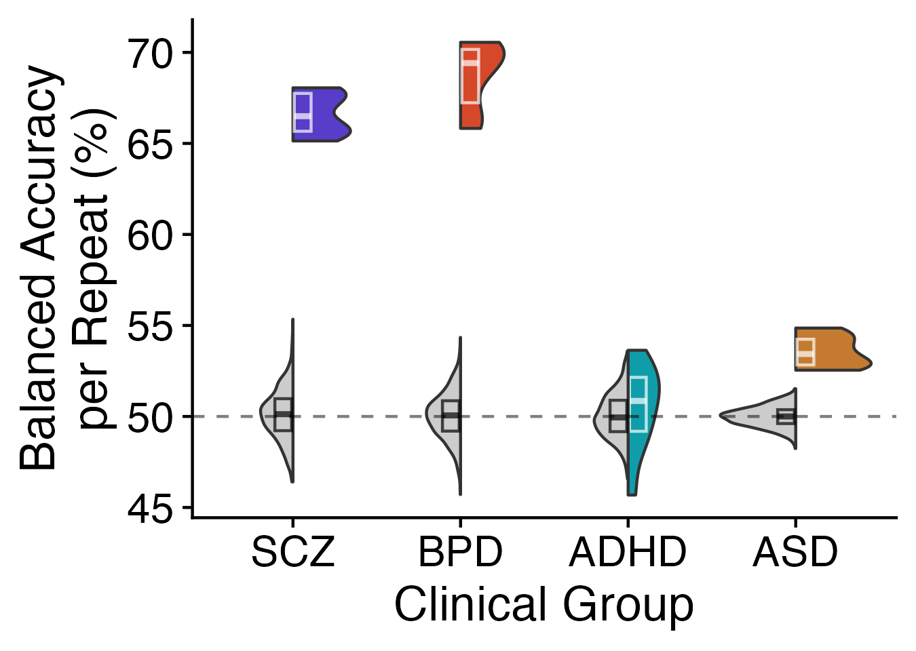
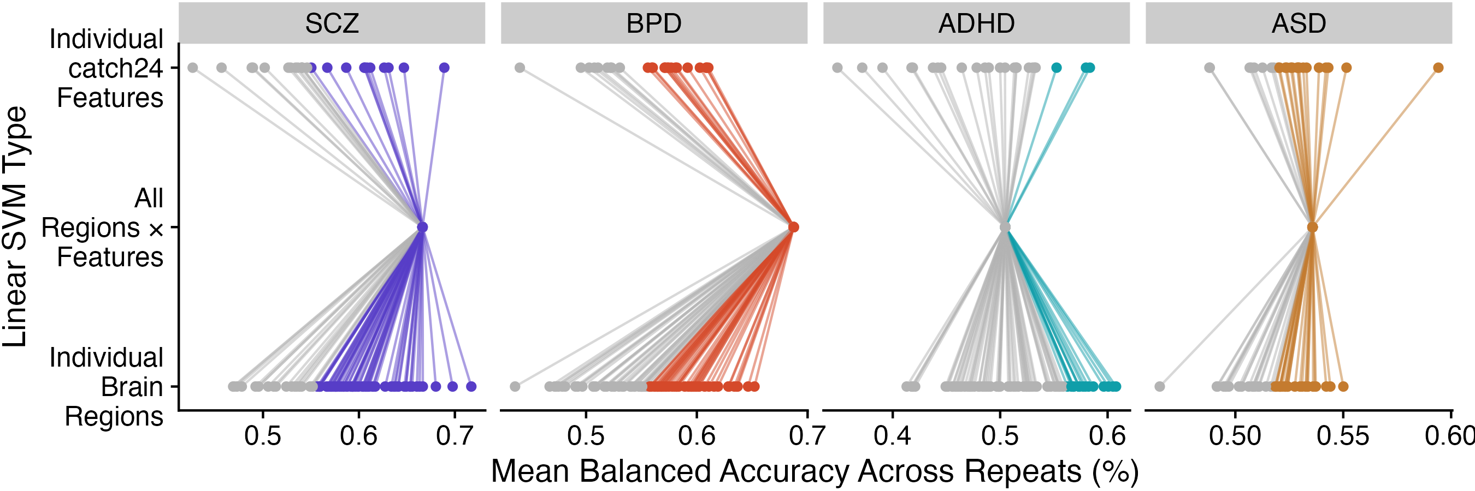
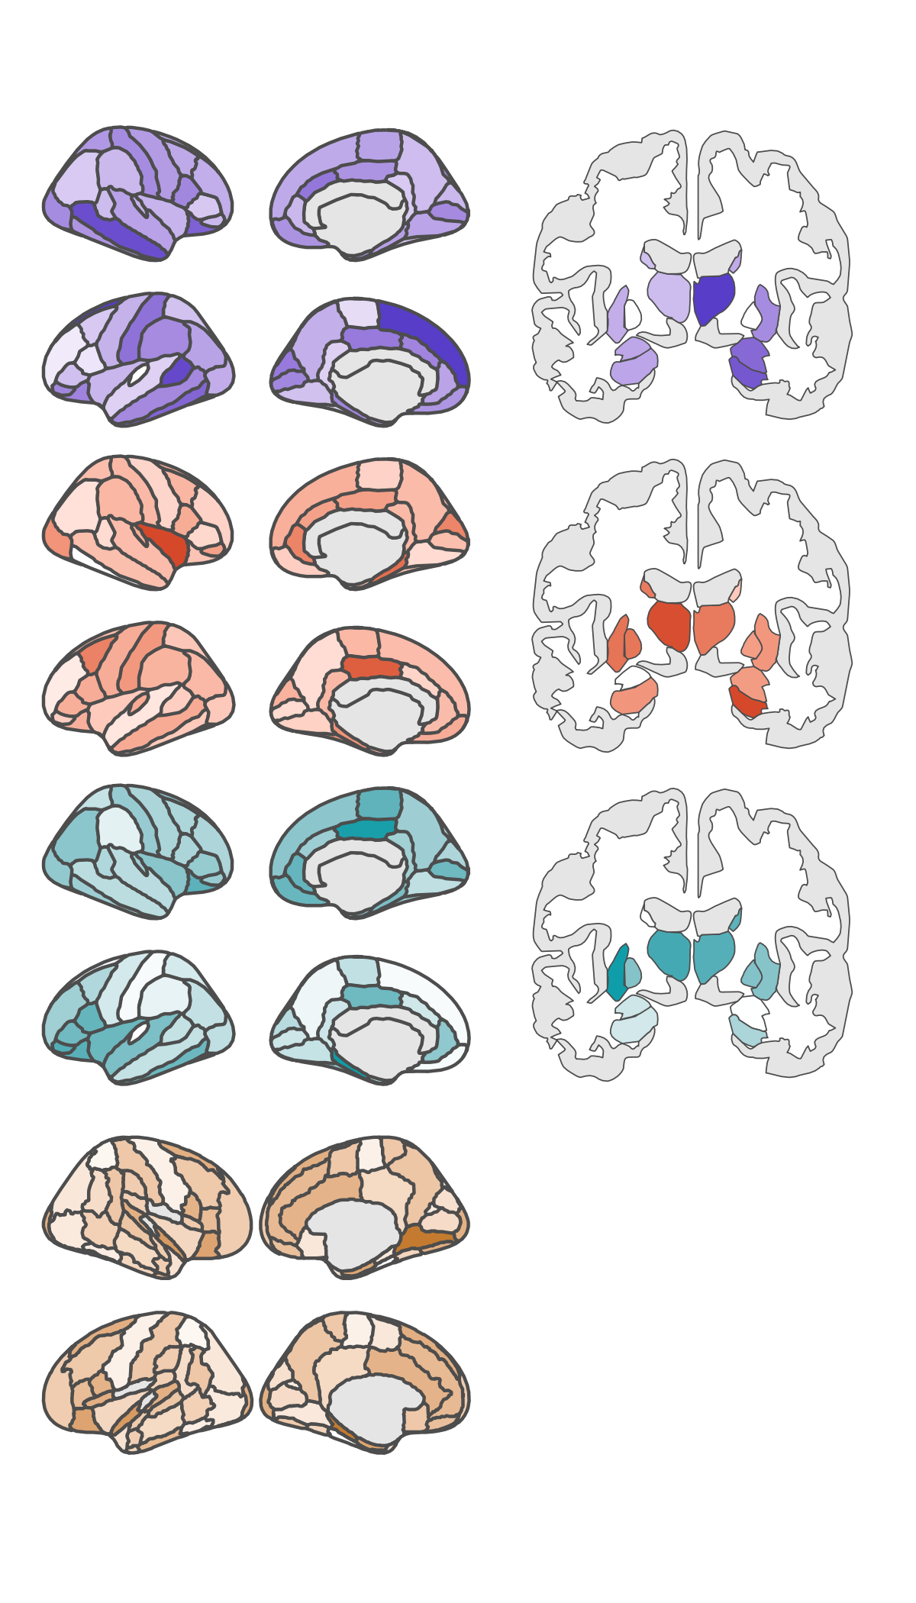
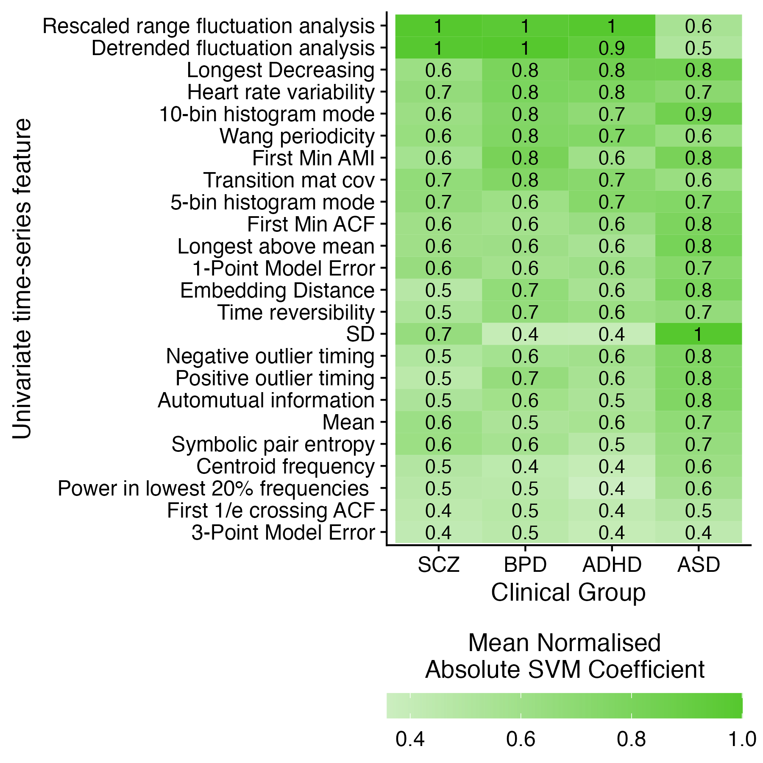
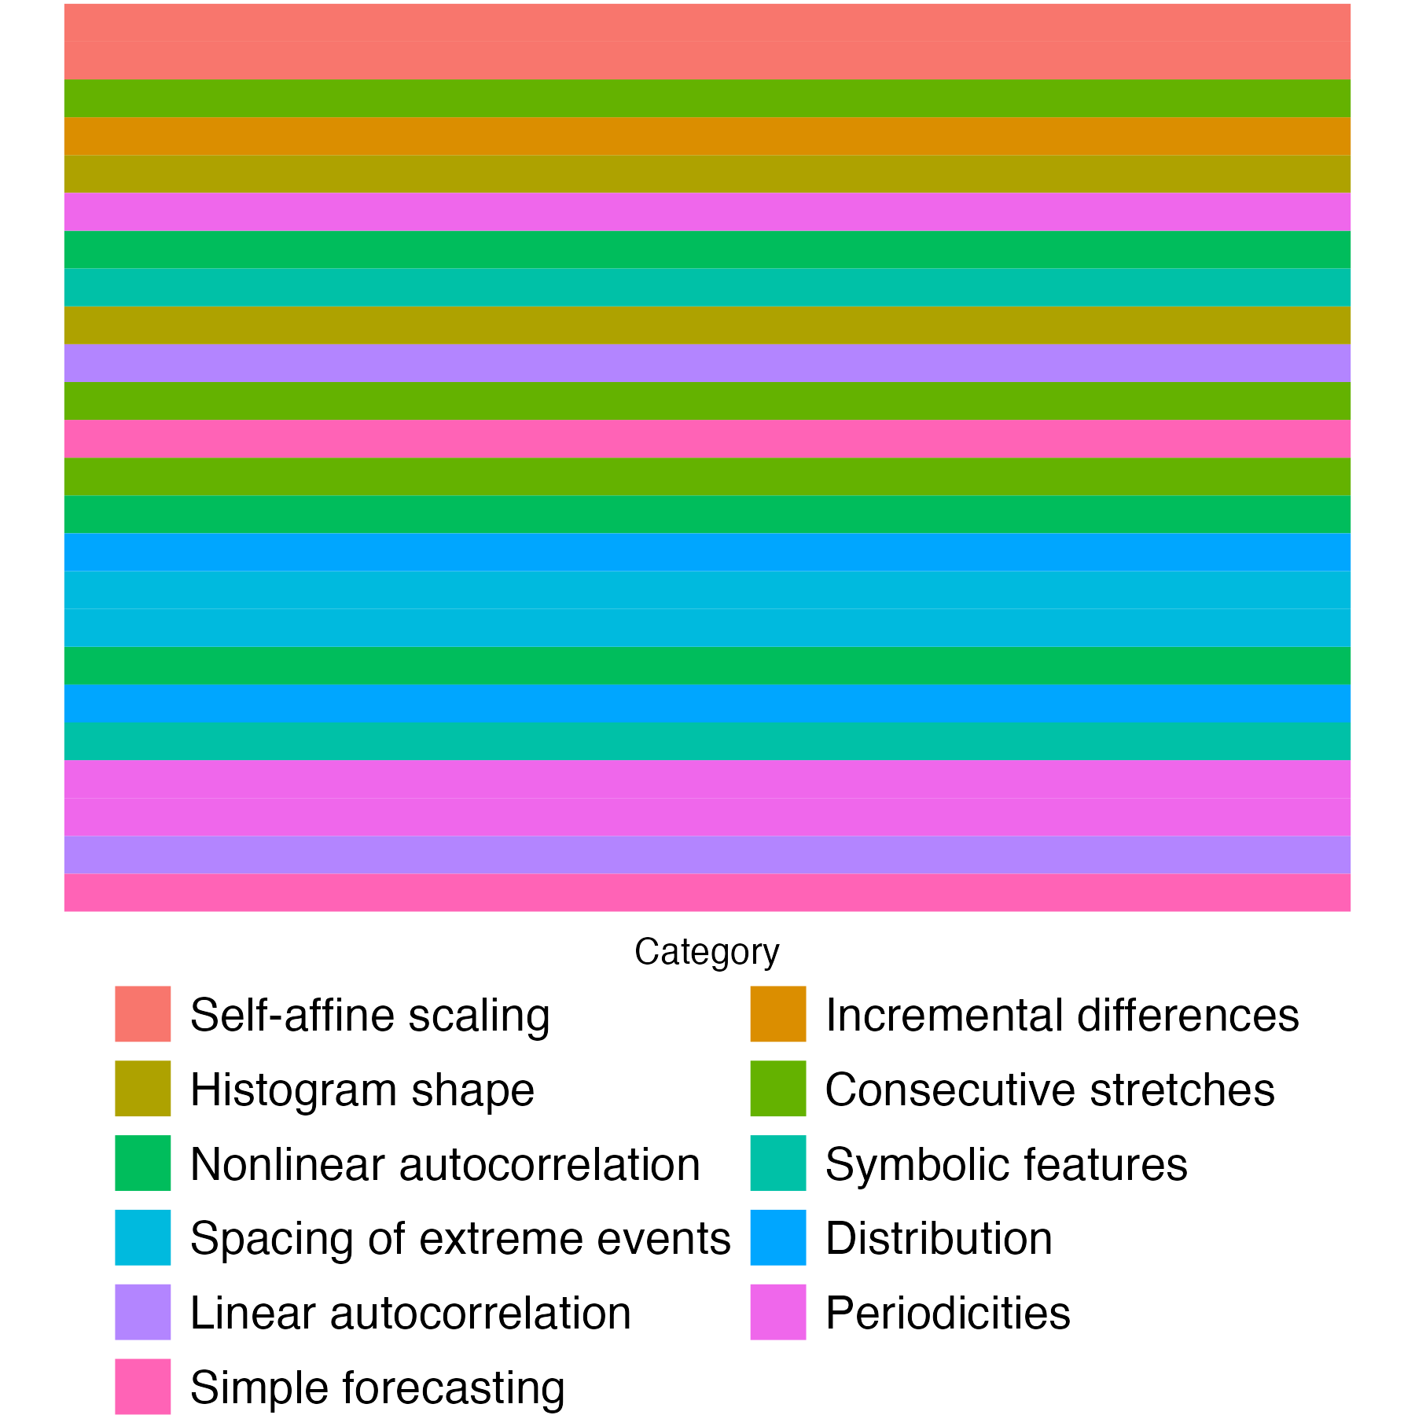
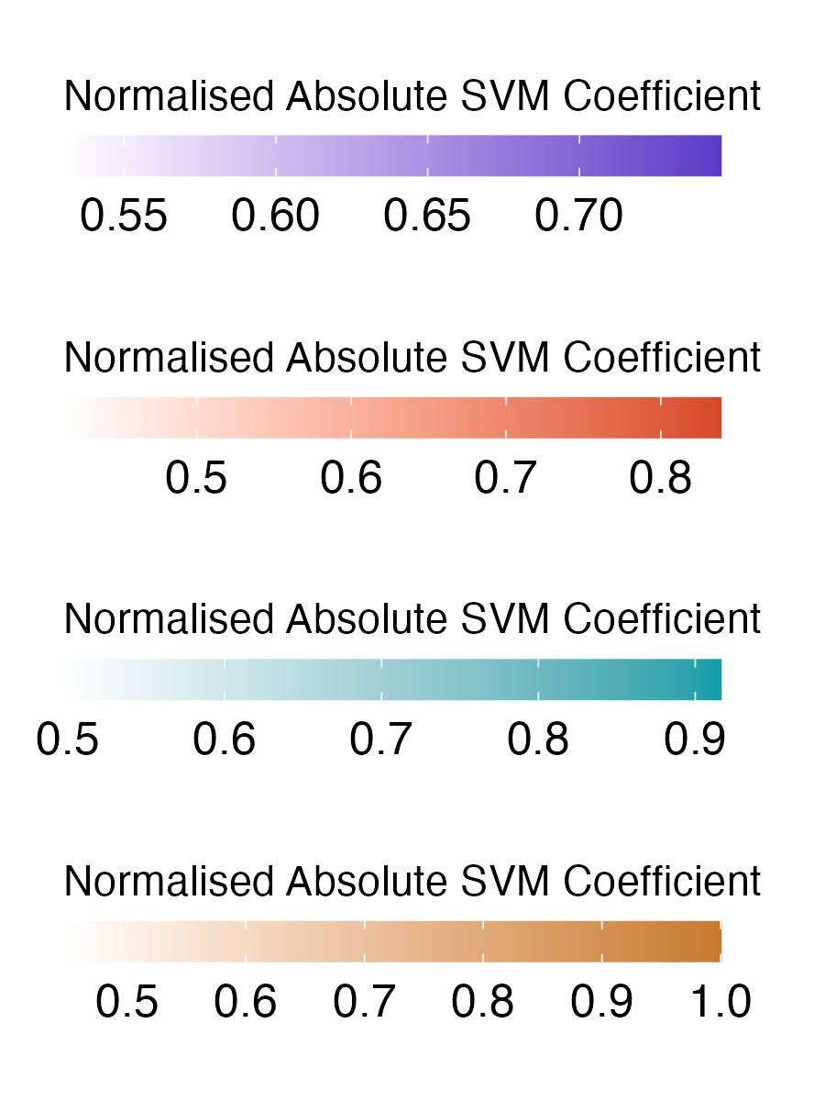
A
Features
Linear SVM
B
C
***
***
***
D
SCZ
BPD
E
ADHD
ASD
Notes:
Figure 2. Univariate time-series feature classification results.

Slide 4
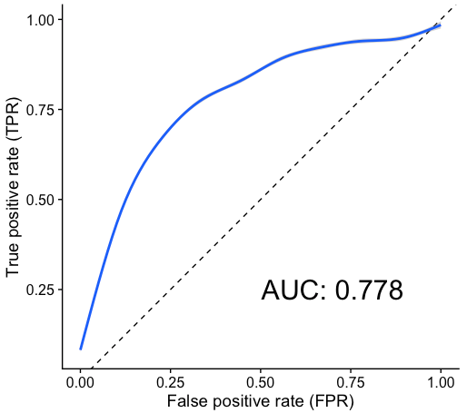
A
Notes:
Figure 2. Univariate time-series feature classification results.

